Slide 1
HMT 801 Travel Agency and Tour Operations
UNIT 5
Travel Bodies and Association
Topic
History, aims and role of PATA & TAAI
Course Outcome (CO)
CO5: Evaluate the Sustainability of Travel operations and activities of travel bodies and associations

Slide 2
Integration between Government and Professional Bodies
Contribution to regional and national economic development.
In a diverse and fragmented tourism industry, there has arisen a need for integration or you can say some kind of collaboration or partnerships to achieve broad-based support for policies within the industry.
Integration in tourism development in developing countries.
For coordination and cooperation between government and professional bodies.

Slide 3
Integration between Government and Professional Bodies
It is being increasingly recognized that the establishment of integration is closely linked with the improvement of the effectiveness of national tourism organisations (NTOs) which is becoming an important instrument for implementing tourism policies more effectively.

Slide 4

.

Slide 5

PATA Headquarters- Thailand

Slide 6
Contact us
Contact us.
PATA Headquarters
Level 26, Gaysorn Tower, 127 Ratchadamri Road, Lumpini, Pathumwan, Bangkok 10330 Thailand Tel: +66 (0)2-017-5757 E-mail: communications@PATA.org
PATA China
Beijing, China Tel: +86 (0)10 6500-1397 Fax: +86 (0)10 6500-1497 E-mail: china@patachina.org
PATA Europe, West Asia, Africa
London, UK Tel: +44 (0) 7932 074-978 E-mail: europe@PATA.org

Slide 7
AIM
Pacific Asia Travel Association (PATA) is the largest non-profit, non-political organization in the field of travel and tourism. The objective of the PATA is the promotion and development of tourism, advancement of the interest of members.
PATA is a membership association acting as a catalyst for the responsible development of the Asia Pacific travel and tourism industry.

Slide 8
Objective
• To stimulate and develop public-private sector partnerships.
• To improve international understanding and international corporation.
• To provide a common forum.
• To publish material relating the tourism industry.
• HR development.
• Marketing research and statics.
• To provide valuable insights, forecasts, and analysis help members to make better business decisions.
• To promote and develop tourism in the Pacific region.
• To provide timely up-to-date and informed.
• To organize seminars/ conferences for the members.
• Build the business of members.
• To organize training and development programs for members.
• To promote ethical practices.
• To focus on destination development.
• To take the lead position on travel and tourism industry issues that need to be addressed.

Slide 9
PATA Membership
The membership of the PATA is open to all organizations which contribute in the travel and tourism sector directly and indirectly. Generally, the membership of PATA is open to all professional organizations such as airlines, steamship lines, travel agencies, tour operators, hoteliers, government, tourism professional organizations, advertising agencies, and public relations agencies, etc.

Slide 10
PATA has 4 types of Membership
PATA
Membership
Active Member
Associate Member
Allied Member
Affiliated Member

Slide 11
.
PATA has 95 government state and city tourism bodies, 25 international airlines and airports, 108 hospitality organizations, 72 educational institutions, and hundreds of travel industry companies in the Asia Pacific and beyond. Thousands of travel industry professionals belong to PATA.
Every year the member of PATA meet at an annual conference to discuss various issues and activities of the association. The member elects the Board of Directors for three or two years terms. The control and management of PATA are vested in the hands of active members.
The board of director (50) meets every month at its headquarter. The head of the association is the president elected by the members of assisted by a full-time vice-president and other administrative professionals, to carry out the smooth functioning of the corporation.

Slide 12
Roles and Functions of PATA
Generally, PATA’s main aim is the progressive development and promotion of tourism to its member countries. The contribution, role, and functions of PATA towards its members can be studied under the following points:
• PATA conducts research studies on tourism.
• PATA organizes marketing programs.
• Provides detailed and up-to-date information.
• Organize events in the Pacific region.
• Helps in economic development.
• PATA helps in the improvement of tourist plants and service facilities.

Slide 13
Pacific Asia Travel Association (PATA)
Working to promote the responsible development of travel and tourism in the Asia Pacific region.
PATA was founded in the year 1951 in Honolulu (Hawaii Island), when Lorrin P. Thurston, president of two major daily newspapers in Honolulu, and William J Mullahey of Pan American Airways set about organizing the first Pacific area travel conference with the aim of promoting tourism to the largely undiscovered region of Asia Pacific.
The association had 44 founder members.
PATA’s first conference was held in January 1952 in Honolulu and its headquarters were established in San Francisco, USA in 1953.
PATA has its own Director for Europe who is based in London and works to promote traffic from the European markets into the Pacific Region.
PATA’s first Asian office was opened in Manilla, Philippines in 1976.

Slide 14
PATA Code of Ethics – Statement
The Pacific Asia Travel Association (PATA) is a not-for-profit membership association that acts as a catalyst for the responsible development of travel and tourism to, from and within the Asia Pacific region. Since 1951, PATA has led from the forefront as the leading voice and authority on travel and tourism in the Asia Pacific region. As the premier travel and tourism industry association in the Asia Pacific region, the Association endorses the UN Global Code of Ethics for Tourism and supports the work of the World Committee on Tourism Ethics, encouraging its members to also do the same.
PATA understands the role of tourism in promoting peace, empathy and cross-cultural understanding, and encourages all tourism stakeholders to observe these fundamental principles. Aligned with these principles, the Association supports the right of freedom of movement without prejudice and intolerance in line with the rights of each sovereign nation and the will of its people.

Slide 15
PATA Code of Ethics – Statement
It is the Association’s position to ensure there is equal opportunity for all travellers without discrimination or harassment on the basis of race, colour, religion, sexual orientation, gender identity or expression, age, disability, marital status, citizenship, genetic information, or any other characteristic protected by relevant laws, legislation and regulations.
Tourism should be a force for good and PATA encourages all public and private industry stakeholders to join in embracing these principles and displaying the tolerance which protects and enhances human society as expressed through the UN’s Sustainable Development Goals.

Slide 16
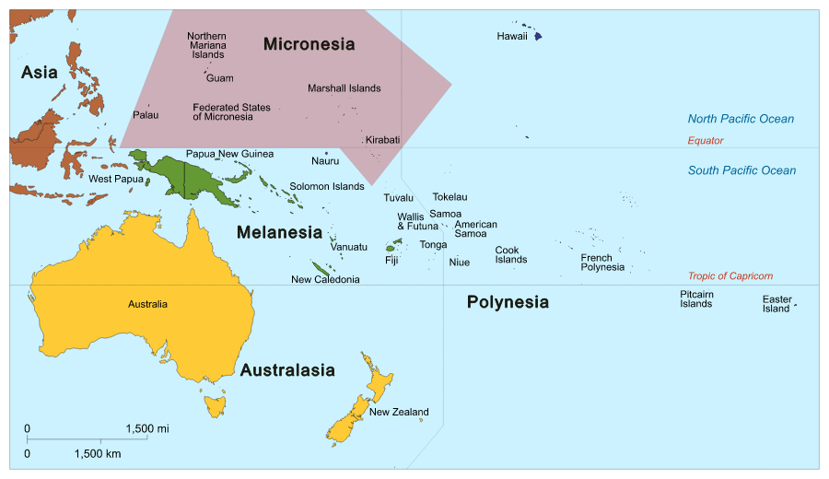
Micronesia

Slide 17
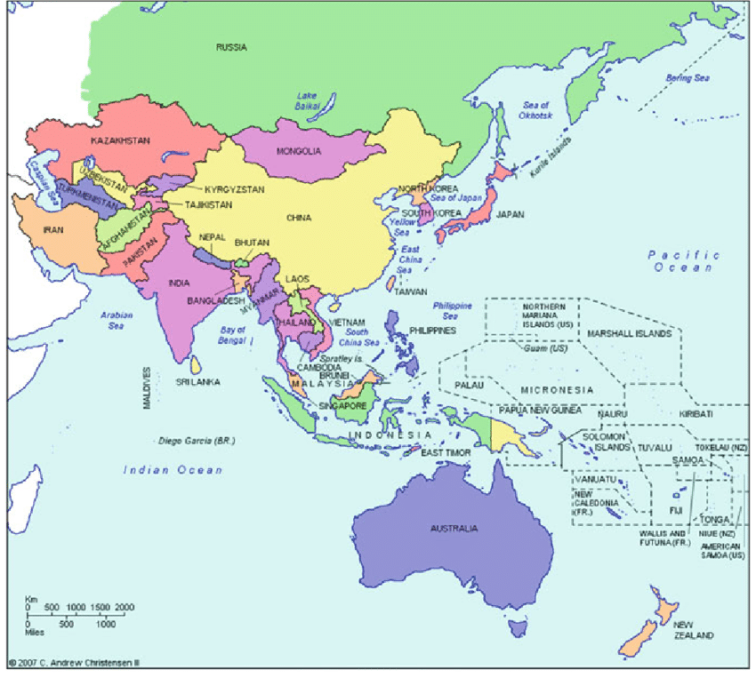

Slide 18
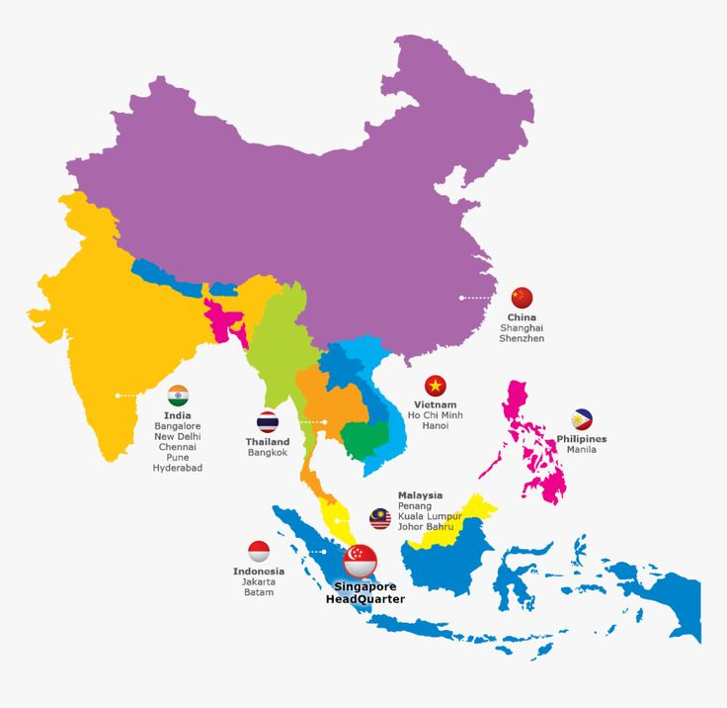

Slide 19
.
Founded in 1951, the Pacific Asia Travel Association (PATA) is a not-for-profit membership-based association that acts as a catalyst for the responsible development of travel and tourism to, from and within the Asia Pacific region.
By bringing together our private and public sector members, PATA facilitates meaningful partnerships to enhance the value, quality and sustainable growth of travel and tourism to, from and within the Asia Pacific region.
The Association provides aligned advocacy, insightful research and innovative events to its member organisations, which including government, state and city tourism bodies; international airlines and airports; hospitality organisations, and educational institutions, as well as thousands of young tourism professional (YTP) members across the world.

Slide 20
.
The PATA network also embraces the grassroots activism the PATA Chapters and Student Chapters, who organise numerous travel industry training programmes and business development events across the world. Thousands of travel professionals belong to the 32 local PATA Chapters worldwide, while hundreds of students are members of the 28 PATA Student Chapters globally.
PATA’s Head Office has been in Bangkok since 1998. The Association also has official offices or representation in Beijing and London.

Slide 21
PATA Chapters
PATA chapters are established throughout the world to assist in the fulfilment of the objectives of the association.
They are the local community organizations of the travel industry professionals who join a cooperative endeavour- within the framework of PATA- to develop travel and tourism to, from and within the pacific area.
The chapters arrange meetings, seminars, conferences and travel marts for tourism in the Asia-Pacific region.

Slide 22






America

Slide 23







Europe

Slide 24




Northeast Asia

Slide 25

Pacific

Slide 26






South Asia

Slide 27







Southeast Asia

Slide 28
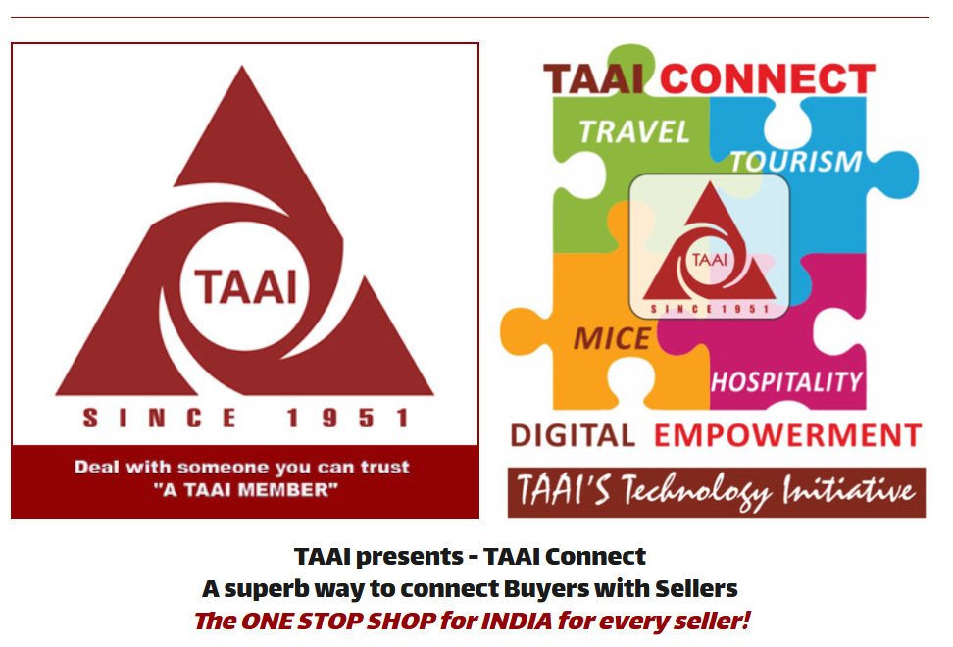
TAAI: Travel Agents Association of India

Slide 29
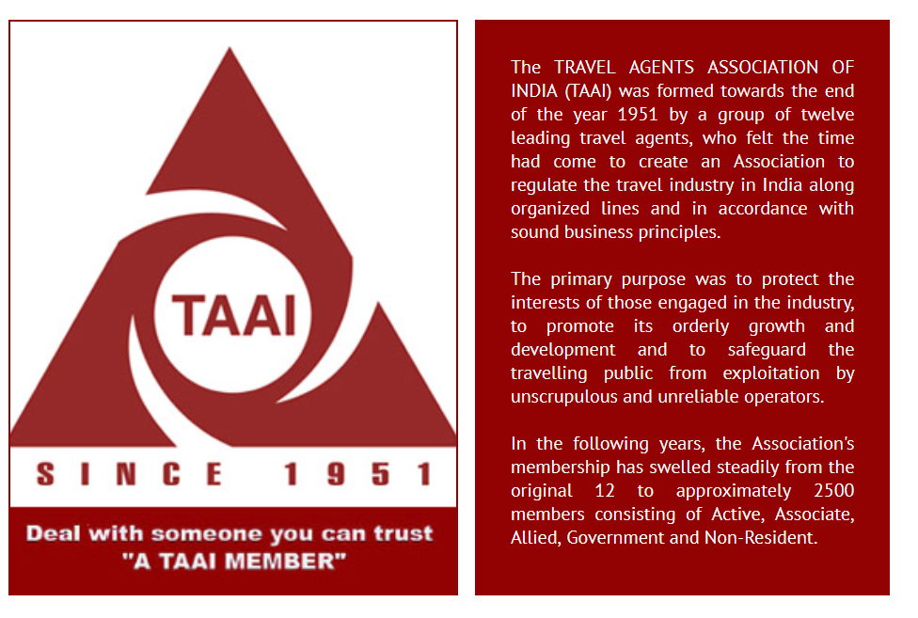

Slide 30
What is TAAI
Apply superior technical skills to the jobs on hand.
Deliver the highest quality of service.
Act responsibly within sound financial parameters.
Build trust and credibility in the marketplace.
The symbol TAAI is an enforcement of reliable and professional service.

Slide 31
Aims and Objectives
TAAI is conscious of the interest of the travelling public and maintains high ethical standards within the travel trade
TAAI aims at the development of the travel and tourism industry in India by constantly improving the standard of service and professionalism in the industry so as to cater to the needs of the travelers and tourists from within India and overseas.
TAAI is engaged in promoting mutual co-operation among the different segments of the travel and tourism industry, among TAAI members, by contributing to the sound progress and growth of the industry as a whole.

Slide 32
Activities of TAAI
TAAI functions as a powerful platform for interaction of thoughts and experiences.
TAAI helps promote, maintain and stimulate the growth of travel and tourism in the industry.
TAAI educates and equips the members to meet the challenges of tomorrow through conventions and seminars.
TAAI draws the attention of the controlling and regulatory authorities in the country and discusses with them the problems of the industry and works for the survival and betterment of its members.
TAAI maintains close contact with world bodies and represents matters affecting the travel and tourism industry of the country.
TAAI gathers useful information on travel and tourism and disseminates the same to its members for their guidance.
TAAI helps develop better understanding among the different segments of the travel industry and brings them into its fold by offering membership under different categories.
TAAI fosters fraternity among its members.

Slide 33
TAAI
Travel Agents Association of India (TAAI) was incorporated during 1951, 4 years after Indian Independence. It continues most effectively with quality growth and ability to support industry growth. TAAI is India’s premier, nodal, largest and oldest Travel & Tourism Association.
TAAI’smembership of about 2,500+ leading Indian companies involved actively with Tourism brings to its members constant guidance from our 20 Regional Units, which is unique to TAAI and its development of Leadership. Each unit has an elected Chairman, Secretary and Treasurer to effectively administer. Member agencies get to meet regularly. We support road shows; presentations; interaction on industry updates, most effectively.
TAAI is actively associated with the Airlines & IATA. As members of IATA”s APJC (Agency Program Joint Council)we debate on matters on Airline practices. TAAI’s active Airlines Council connects TAAI with Domestic & International Airlines.

Slide 34
TAAI
TAAI works closely with the Ministry of Tourism, Government of India. We actively participate in the Tourism Meetings convenedby the Government. We are actively associated with State Tourism Boards of India.
TAAI has a large membership who isactively involved in several industry verticals, and thus its focus is to promote these effectively and connect members with opportunities.
Airline Ticketing
Outbound Tourism
Inbound Tourism
Domestic Tourism
Hospitality
MICE
Sports Tourism
Destination Promotion & Specialization

Slide 35
TAAI
Destination promotion has been TAAI’s stronghold. TAAI’s connect with Tourism Ministries and Governments; National Tourism Authorities and Boards are immense. We have MOUs to promote bi-lateral tourism with over 25 countries TAAI endears itself to promote outbound into these countries.TAAI is a ONE POINT CONTACT for any country; destination or attraction to be effectively promoted well across India. TAAI Conventions (Indian Travel Congress) are most eagerly awaited events of the Travel & Tourism industry. The huge visibility, this annual event of TAAI, brings to the global industry is fantastic. 800 to 1400 delegates, depending on the destination and TAAI’s decision, are blessed with the excellent opportunity to network; get updated; promote or buy and importantly take home some great learning through our knowledge sessions. TAAI does these events all over the world, including India.

Slide 36


